Slide 1

6th Grade Math
Unit 2, Lesson 6 Dividing Multi-Digit Numbers with Decimals to the Thousandths Volume 1, pg. 73

Slide 2


Benchmark
MA.6.NSO.2.1
Multiply and divide positive multi-digit numbers with decimals to the thousandths, including using a standard algorithm with procedural fluency.
volume 1, pg. 73

Slide 3
Integrated Mathematical Thinking and Reasoning Standards
MA.K12.MTR.3.1 Complete tasks with mathematical fluency.
MA.K12.MTR.5.1 Use patterns and structure to help understand and connect mathematical concepts.
volume 1, pg. 73

Slide 4

Learning Target
I can fluently divide multi-digit numbers with decimals to the thousandths.
volume 1, pg. 73

Slide 5

Warm-Up
volume 1, pg. 74

Slide 6
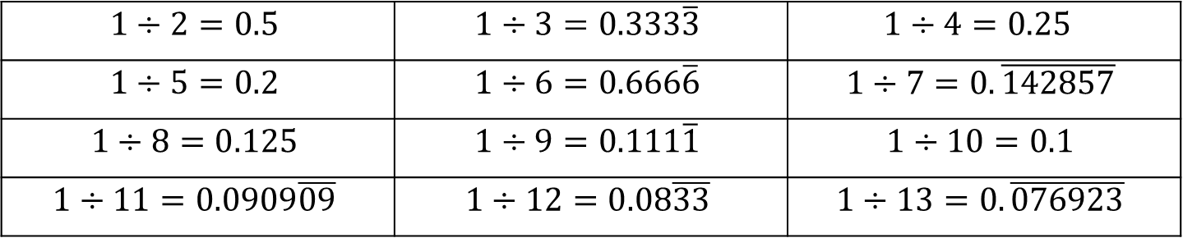
2.6.1 Warm-Up: Quotients as Decimals
The quotients of several division expressions are shown.
$$1÷2=0.5$$ | $$1÷3=0.333\overline{3}$$ | $$1÷4=0.25$$
$$1÷5=0.2$$ | $$1÷6=0.666\overline{6}$$ | $$1÷7=0.\overline{142857}$$
$$1÷8=0.125$$ | $$1÷9=0.111\overline{1}$$ | $$1÷10=0.1$$
$$1÷11=0.0909\overline{09}$$ | $$1÷12=0.08\overline{33}$$ | $$1÷13=0.\overline{076923}$$
volume 1, pg. 74

Slide 7
Write something you notice about the values of the quotients and something you still wonder.
I notice… | I wonder…
volume 1, pg. 74

Slide 8

Refresher
volume 1, pg. 74

Slide 9

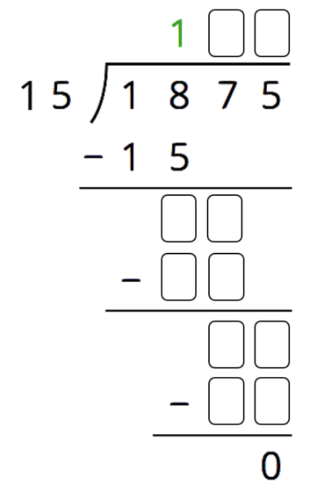
2.6.2 Refresher: Long Division
Jiang was dividing using long division and got stuck.
Complete the problem to show Jiang the missing steps.
volume 1, pg. 74

Slide 10
What advice about long division do you have that could help Jiang in the future?
volume 1, pg. 74

Slide 11

Exploration
volume 1, pg. 75

Slide 12

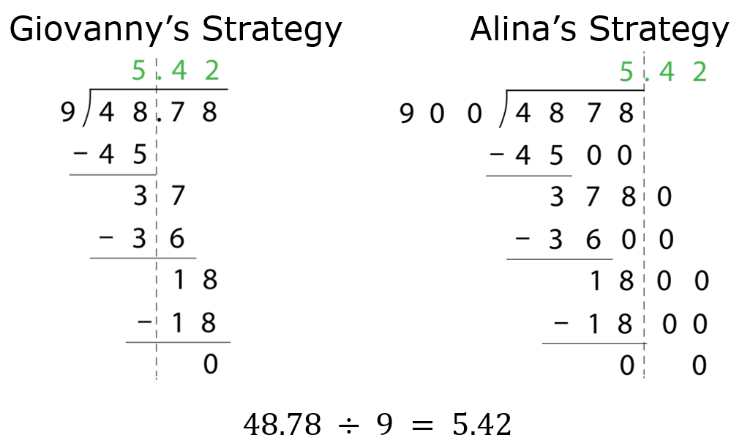
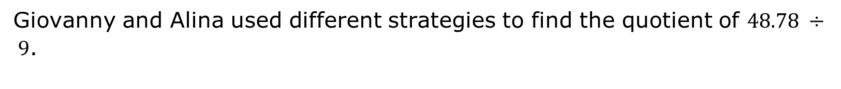
2.6.3 Exploration: Dividing Decimals
Giovanny and Alina used different strategies to find the quotient of $48.78 ÷ 9$.
volume 1, pg. 75

Slide 13
Work with your partner to answer the questions about Giovanny and Alina’s strategies.
How are the two students’ calculations alike and different?
Similarities | Differences
volume 1, pg. 75

Slide 14
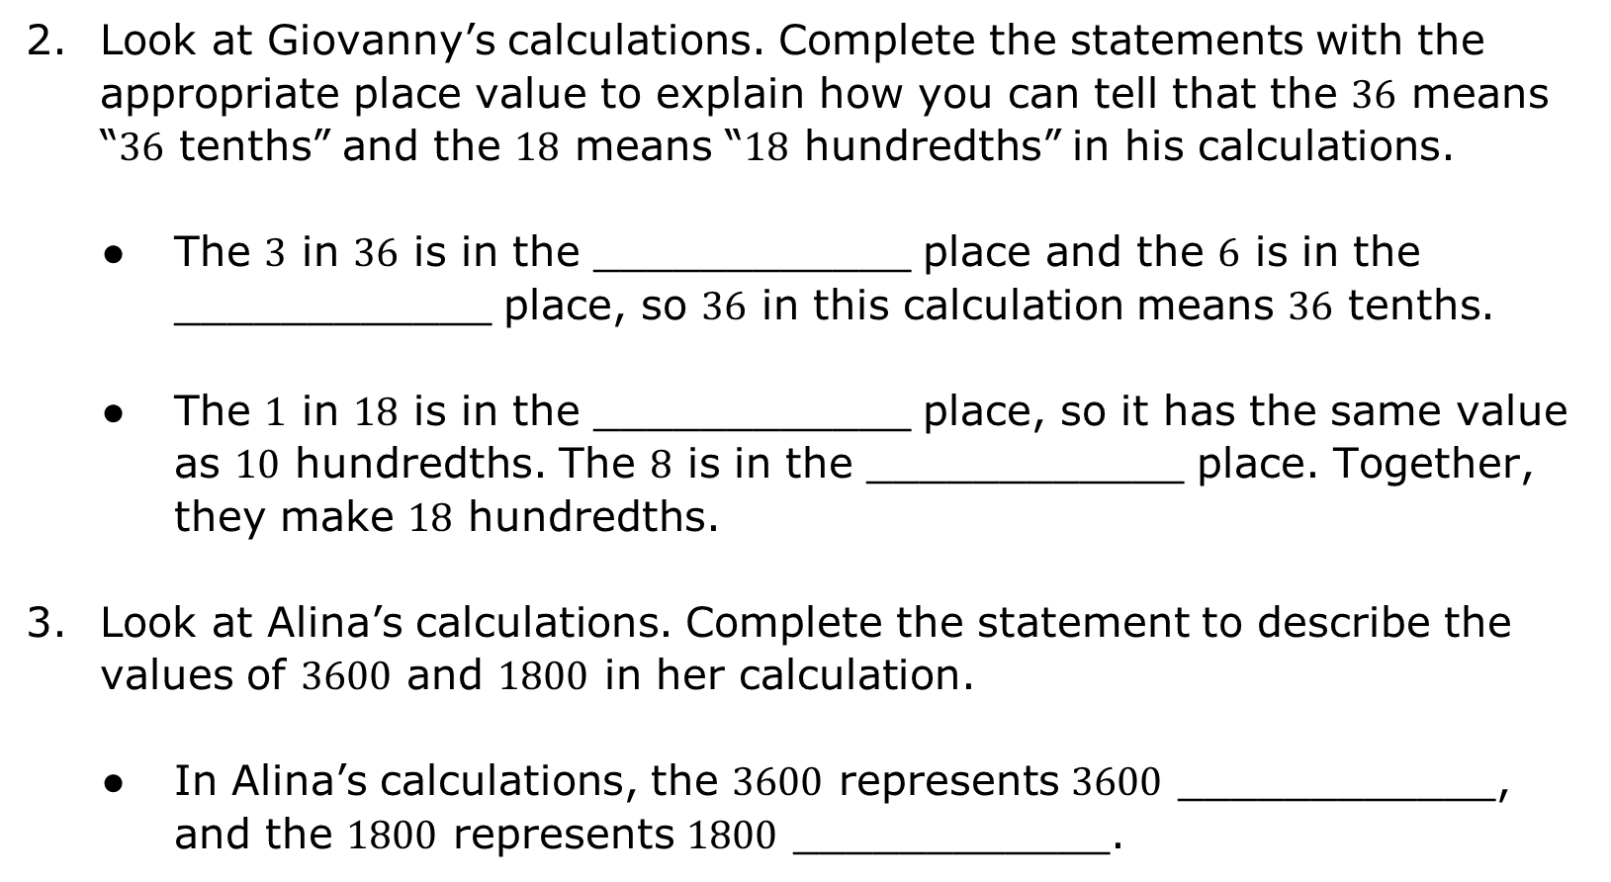
Look at Giovanny’s calculations. Complete the statements with the appropriate place value to explain how you can tell that the $36$ means “$36$ tenths” and the $18$ means “$18$ hundredths” in his calculations.
The $3$ in $36$ is in the ____________ place and the $6$ is in the ____________ place, so $36$ in this calculation means $36$ tenths.
The $1$ in $18$ is in the ____________ place, so it has the same value as $10$ hundredths. The $8$ is in the ____________ place. Together, they make $18$ hundredths.
Look at Alina’s calculations. Complete the statement to describe the values of $3600$ and $1800$ in her calculation.
In Alina’s calculations, the $3600$ represents $3600$ ____________, and the $1800$ represents $1800$ ____________.
volume 1, pg. 75

Slide 15

Why is the value of $48.78 ÷ 9$ the same as the value of $4878 ÷ 900$?
Explain why $51.84 ÷ 6.4$ has the same value as $518.4 ÷ 64$.
Find the value of $51.84 ÷ 6.4$ using long division. Show your work.
volume 1, pg. 75

Slide 16

Bring It Together
volume 1, pg. 76

Slide 17

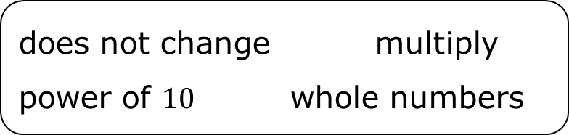
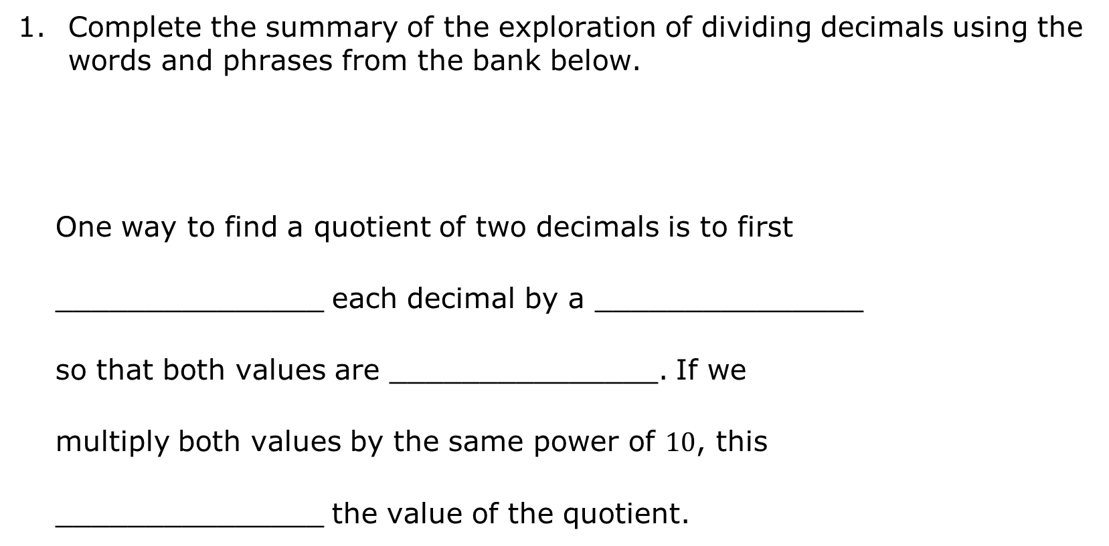
2.6.4 Bring It Together: Dividing Decimals
Complete the summary of the exploration of dividing decimals using the words and phrases from the bank below.
One way to find a quotient of two decimals is to first
_______________ each decimal by a _______________
so that both values are _______________. If we
multiply both values by the same power of $10$, this
_______________ the value of the quotient.
does not change multiply
power of $10$ whole numbers
volume 1, pg. 76

Slide 18

Guided Practice
volume 1, pg. 76

Slide 19


2.6.5 Guided Practice: Dividing Decimals
Find each quotient using a strategy similar to Giovanny’s or Alina’s. Show your work.
a. $24.2÷1.1$
b. $17.028÷0.08$
volume 1, pg. 76

Slide 20
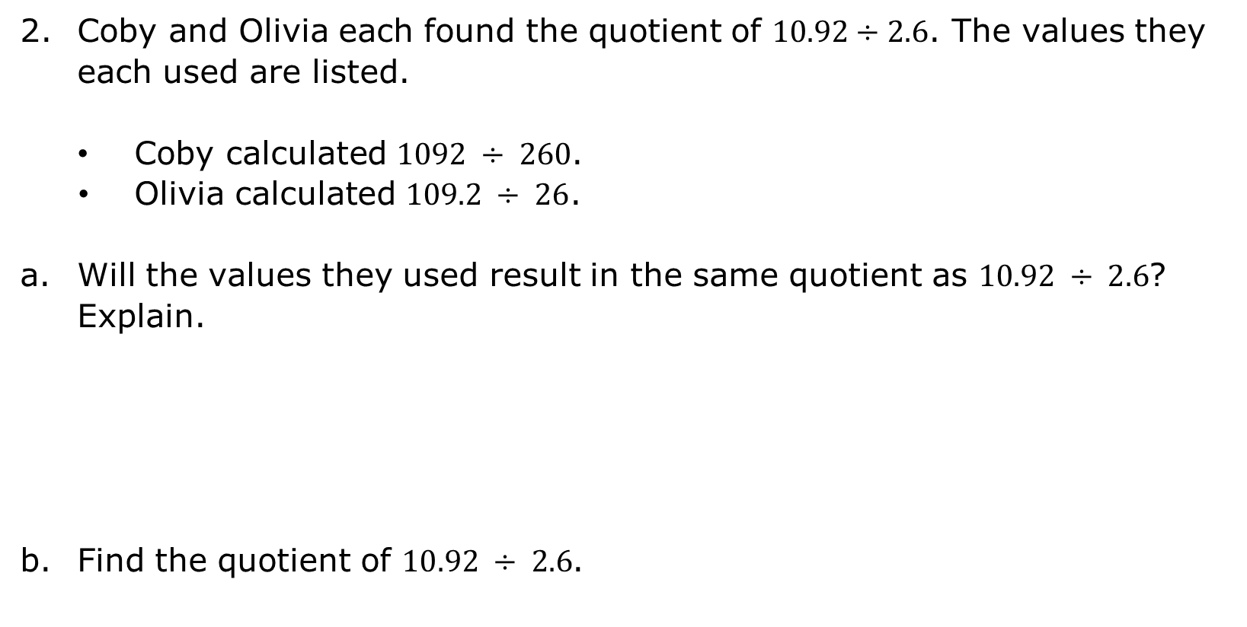
Coby and Olivia each found the quotient of $10.92÷2.6$. The values they each used are listed.
Coby calculated $1092 ÷ 260$.
Olivia calculated $109.2 ÷ 26$.
Will the values they used result in the same quotient as $10.92 ÷ 2.6$? Explain.
Find the quotient of $10.92 ÷ 2.6$.
volume 1, pg. 76

Slide 21

Your Turn
volume 1, pg. 77

Slide 22
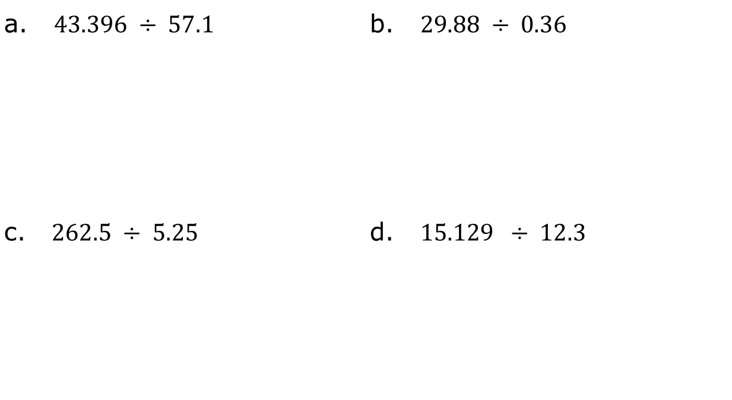
2.6.6 Your Turn!
Find each quotient. Show your work.
a. $43.396 ÷ 57.1$ | b. $29.88 ÷ 0.36$
c. $262.5 ÷ 5.25$ | d. $15.129 ÷ 12.3$
volume 1, pg. 77

Slide 23

Wrap-Up
volume 1, pg. 77

Slide 24
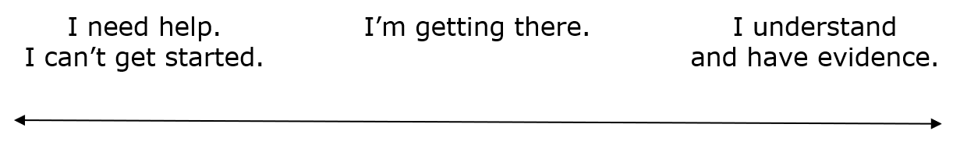
2.6.7 Wrap-Up: Reflection
Draw an X on the line to indicate where your current learning is in relation to the learning target.
I can fluently divide multi-digit numbers with decimals to the thousandths.
Briefly explain why you placed the X where you did.
volume 1, pg. 77

